Slide 1
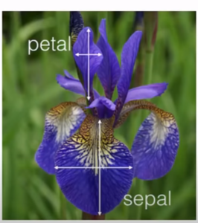
Support vector Machine
A Support Vector Machine (SVM) is a discriminative classifier formally defined by a separating hyperplane. In other words, given labeled training data (supervised learning), the algorithm outputs an optimal hyperplane which categorizes new examples. In two dimentional space this hyperplane is a line dividing a plane in two parts where in each class lay in either side.

Slide 2
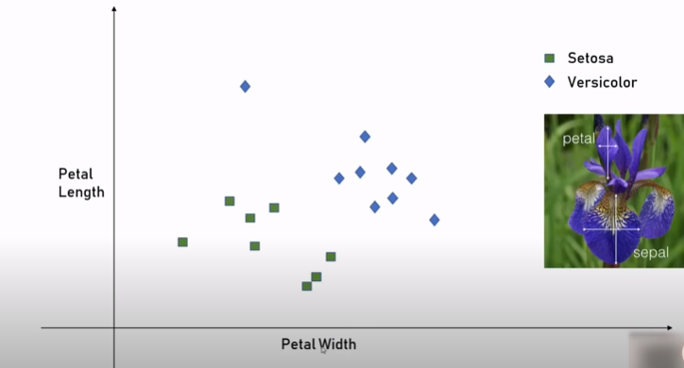

Slide 3
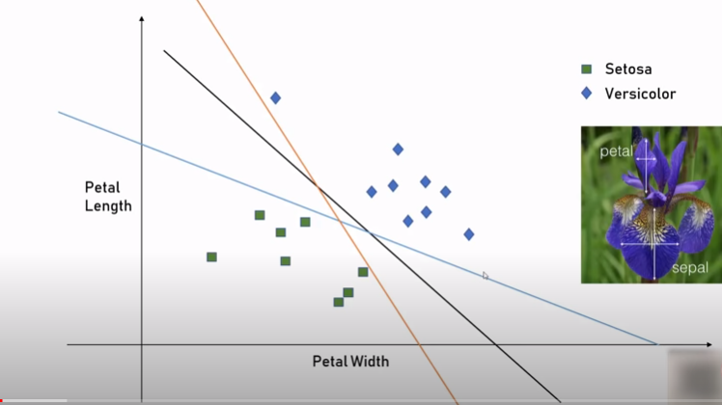

Slide 4
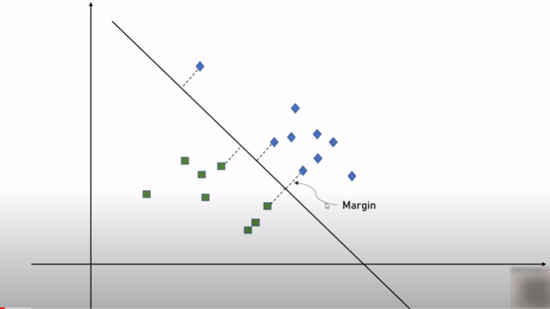

Slide 5
